Slide 1
DBMS Triggers

Slide 2
Triggers are stored programs, which are automatically executed or fired when some events occur.
Triggers are, in fact, written to be executed in response to any of the following events

Slide 3
A database manipulation (DML) statement (DELETE, INSERT, or UPDATE)
A database definition (DDL) statement (CREATE, ALTER, or DROP).
A database operation (SERVERERROR, LOGON, LOGOFF, STARTUP, or SHUTDOWN).
Triggers can be defined on the table, view, schema, or database with which the event is associated.

Slide 4
Example : A trigger can be invoked when a row is inserted into a specified table or when certain table columns are being updated.

Slide 5
Components of trigger (E-C-A Model)
Event(E) – SQL statement that causes the trigger to fire(or activate). This event may be insert, update, or delete operation database table.
Condition (C) – A condition that must be satisfied for execution of trigger.
Action (A) – This code or statement that execute when triggering condition is satisfied and trigger is activated on database table.

Slide 6
Syntax:
create trigger [trigger_name]
[before | after]
{insert | update | delete}
on [table_name]
[for each row]
[trigger_body]

Slide 7
Explanation of syntax:
create trigger [trigger_name]: Creates or replaces an existing trigger with the trigger_name.
[before | after]: This specifies when the trigger will be executed.
{insert | update | delete}: This specifies the DML operation.

Slide 8
on [table_name]: This specifies the name of the table associated with the trigger.
[for each row]: This specifies a row-level trigger, i.e., the trigger will be executed for each row being affected.
[trigger_body]: This provides the operation to be performed as trigger is fired

Slide 9
BEFORE and AFTER of Trigger:
BEFORE triggers run the trigger action before the triggering statement is run. AFTER triggers run the trigger action after the triggering statement is run.

Slide 10
Example:
Given Student Report Database, in which student marks assessment is recorded. In such schema, create a trigger so that the total and average of specified marks is automatically inserted whenever a record is insert.

Slide 11
Here, as trigger will invoke before record is inserted so, BEFORE Tag can be used.
Suppose the database Schema –
mysql> desc Student;

Slide 12
Field | | Type | | Null | | Key | | Default | | Extra
Tid | Int | No | PRI | NULL
Name | Varchar(8) | Yes |  | NULL
Subj1 | Int | Yes |  | NULL
subj2 | Int | Yes |  | NULL
subj3 | Int | Yes |  | NULL
Total | Int | Yes |  | NULL
perc | Int | Yes |  | NULL

Slide 13
SQL Trigger to problem statement.
create trigger stud_marks
before
INSERT
on Student
for each row
set Student.total = Student.subj1 + Student.subj2 + Student.subj3,
Student.perc = Student.total * 60 / 100;

Slide 14
Above SQL statement will create a trigger in the student database in which whenever subjects marks are entered, before inserting this data into the database, trigger will compute those two values and insert with the entered values. i.e.,

Slide 15
mysql> insert into Student values(100, "ABCDE", 20, 20, 20, 0, 0); Query OK, 1 row affected (0.09 sec)
mysql> select * from Student;
tid | name | subj1 | subj2 | subj3 | total | perc |
+-----+-------+-------+-------+-------+-------+------+
| 100 | ABCDE | 20 | 20 | 20 | 60 | 36 |

Slide 16
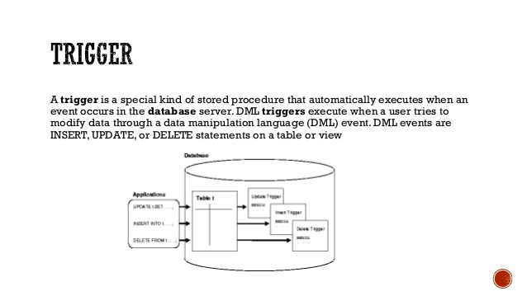

Slide 17
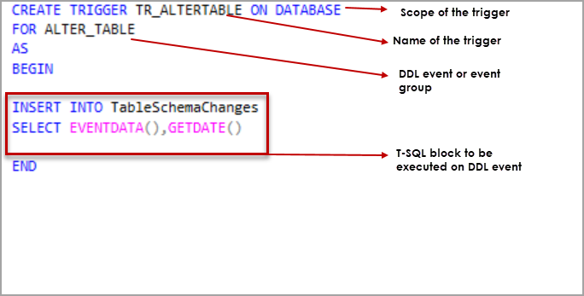

Slide 18
In the below trigger, we are trying to calculate the percentage of the student as soon as his details are updated to the database.
CREATE TRIGGER sample_trigger
before INSERT
ON student
FOR EACH ROW
SET new.total = new.marks/6;

Slide 19
Operations in Triggers
Display A Trigger
SHOW TRIGGERS;
SHOW TRIGGERS IN database_name;
DROP A Trigger
DROP TRIGGER trigger name;

Slide 20
Before insert and After insert Example
CREATE TABLE Student(
studentID INT NOT NULL AUTO_INCREMENT,
FName VARCHAR(20),
LName VARCHAR(20),
Address VARCHAR(30),
City VARCHAR(15),
Marks INT,
PRIMARY KEY(studentID)
);

Slide 21


Slide 22
Before Insert
CREATE TRIGGER calculate
before INSERT
ON student
FOR EACH ROW
SET new.marks = new.marks+100;
*Here the “NEW” keyword refers to the row that is getting affected.

Slide 23
Here when we insert data into the student table automatically the trigger will be invoked. The trigger will add 100 to the marks column into the student table.
29+3(automatically added)

Slide 24
After Insert
To use this variant we need one more table i.e, Percentage where the trigger will store the results. Use the below code to create the Percentage Table.
create table Final_mark(per int );

Slide 25
Now let us use the after insert trigger
CREATE TRIGGER total_mark
after insert
ON student
FOR EACH ROW
insert into Final_mark values(new.marks);

Slide 26
Here when we insert data to the table, total_mark trigger will store the result in the Final_mark table.

Slide 27
Advantages
Triggers are useful for enforcing referential integrity, which preserves the defined relationships between tables when you add, update, or delete the rows in those tables. Make sure that a column is filled with default information.
After finding that the new information is inconsistent with the database raise an error that will cause the entire transaction to roll back.

Slide 28
Disadvantage
Triggers may increase the overhead of the database
Triggers can be difficult to troubleshoot because they execute automatically in the database.

Slide 29
Thank you !

